Slide 1
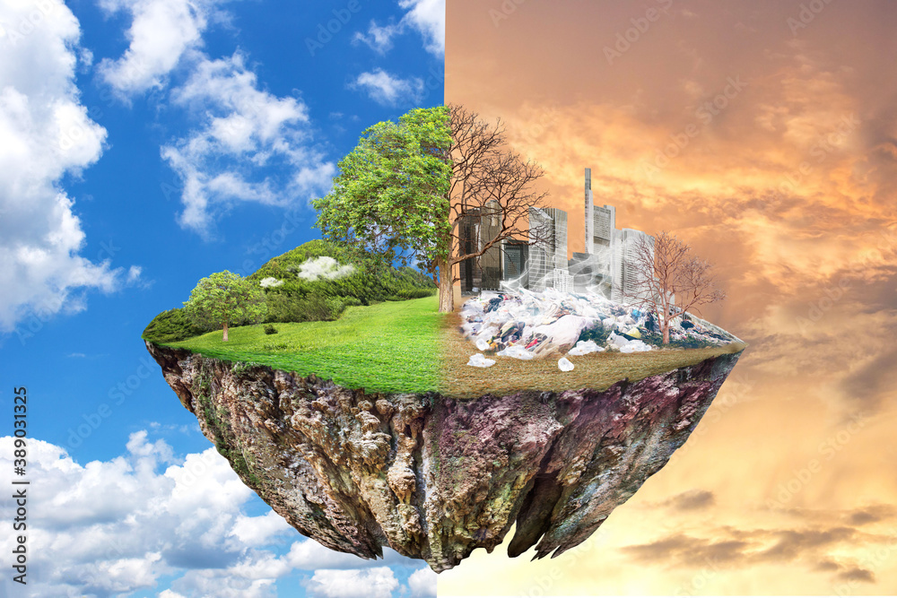
Effect of Climate Change and Future

Slide 2
What we learn today………
Introduction
What causes climate change?
Hazards and impacts

Slide 3
Introduction

Slide 4
Weather
Weather refers to conditions like rain, temperature and wind over hours to days
LOOK out the window now. What is the weather like?

Slide 5
Climate
Climate refers to average weather conditions over a long period of time (30+ years)
THINK about what the weather is normally like on your birthday? - Is it normally dry or wet / hot or cold?

Slide 6
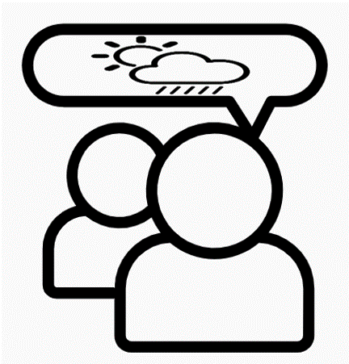
Climate change
Climate change is a statistically significant change in the state of the climate (average weather) that persists for an extended period of time (decades or longer)
ASK an elder what the weather was normally like 30 years ago, in your birthday month? Has it changed?

Slide 7
What causes climate change?

Slide 8
The Greenhouse Effect
Sunlight passes through the atmosphere to earth
At earth’s surface it’s reflected back through the atmosphere to space
However! After it is reflected, greenhouse gases can trap heat in the atmosphere
We call this process the greenhouse effect; as it is similar to a greenhouse
Greenhouse gases act like a big blanket around the earth, trapping heat
Notes:
Can anyone explain this?

Slide 9
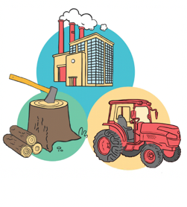
Greenhouse gases
Greenhouse gases trap heat from the sun in the atmosphere, after it is reflected from earth
Greenhouse gases occur naturally in the atmosphere
Without them, the earth would be very cold – about minus 18°C ! All water on earth would freeze, the oceans would turn to ice and life as we know it would not exist
Notes:
Major greenhouse gases are shown in the blue box

Slide 10
Human activity
Over the last 100 years, since the industrial revolution, greenhouse gases have rapidly increased in the atmosphere
This is due to human activities which release greenhouse gases
Electricity from coal or diesel generators and industry or pollution from factories contribute the most

Slide 11
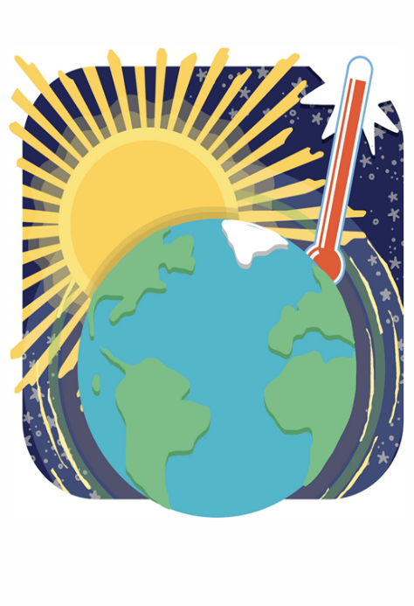
Global warming
More greenhouse gases trap more heat in the atmosphere, leading to global warming
Since 1880, global temp has increased by almost 1°C
How much this rises depends on how much more greenhouse gas is released
Temp could rise by almost 5°C by 2100. However, countries around the world agreed to keep this below 2°C
Humans have added so much greenhouse gas to the atmosphere, that even if all emissions stopped today, the planet would still continue to warm for decades to come

Slide 12
1°C or 2°C warmer sounds small?
1°C or 2°C - might not sound like much, but think about what happens when your body temperature is increased by 1 or 2 degrees?
You would immediately fall sick and get a fever

Slide 13
Global warming & the water cycle
Global warming intensifies the water cycle
Higher temps increase evaporation of water from sea, lakes, rivers
Warmer air holds more water vapour, resulting in more intense rainstorms. This can lead to flooding
More floods where water runs off into rivers and streams, does little to dampen the soil. This increased temps can lead to drought
Weather patterns across the world are effected over time
This results in CLIMATE CHANGE
Notes:
THE WATER CYCLE
The earth has a limited amount of water. It keeps going around in what we call the “Water Cycle”:
The sun heats water in rivers, lakes or the ocean. Water EVAPORATES becoming water vapour.
The vapour rises into the air. When it reaches the colder atmosphere it CONDENSES to form clouds.
As more water vapour collects in the clouds, the clouds become heavier. When they can't hold the water vapour, water falls back from the clouds back to Earth as PRECIPITATION - such as rain, hail or snow.
The precipitation COLLECTS in the oceans, lakes or rivers, or may end up on land.
We know that changes in the water cycle are increasing the risks of floods and droughts (climaterealityproject).

Slide 14
Hazards and impacts

Slide 15
Climate change, hazards & impacts
Climate Change is exacerbating a range of weather related hazards around the world
Climate change makes some hazards more frequent
Climate change makes some hazards more intense
These hazards impact people around the world
The same hazard can have different impacts for different people

Slide 16
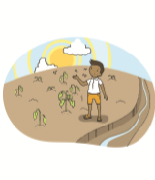
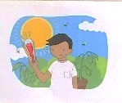
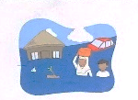
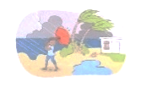
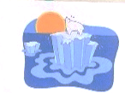
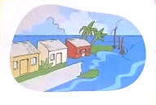
Scientists project:
Temperature increase (0.3 – 4.8°C by 2100)
Heat waves - more often and last longer
Extreme precipitation events (rain, snow)
- more often and more intense
Precipitation increases in wet regions
Precipitation decreases in dry regions
Increase in tropical cyclone wind speeds
Decreased snow / ice extent
Rising sea level
Warming and acidification of oceans
Source: IPCC 2014, AR5
Reference:- IPCC Special Report on Global Warming, UNEP Emissions Gap Report, World Bank "Turn Down the Heat" Series
Notes:
What do you think that scientists project?
Temperature increase range shows projected increase of global mean surface temperature by the end of the 21st century (2081–2100) relative to 1986–2005, depending on how much greenhouse gas emissions are reduced

Slide 17
Thanks

